Slide 1
Melbourne Housing Market
Parth Barhanpurkar
Mounica Subramani
Viral Patel
Source : https://www.kaggle.com/anthonypino/melbourne-housing-market/data

Slide 2
Description
Analyzing the “Melbourne Housing Market”, which is currently experiencing a housing bubble. The price of houses rose with stunning figures.
The dataset includes Address, Type of Real estate, Suburb, Method of Selling, Rooms, Price, Real Estate Agent, Date of Sale and distance from C.B.D. and extra data including property size, land size and council area. We analyzed the data to find the House price influencers from the above list.
We are focusing on finding a trend or giving a prediction of this housing bubble say, which suburbs are the best to buy in? Which ones are worth the money? Where's the expensive side of town? And more importantly where should I buy a two bedroom unit?

Slide 3
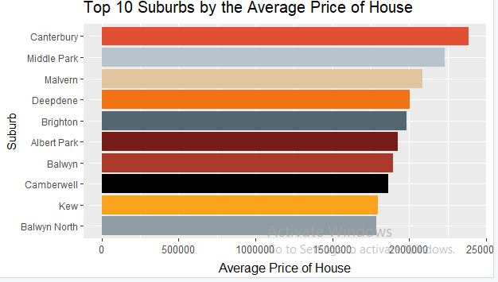
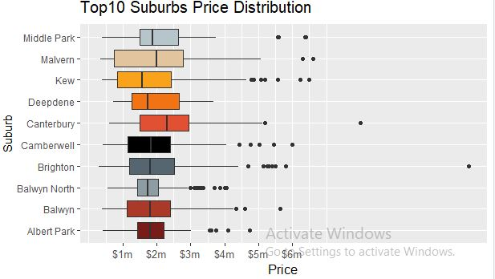
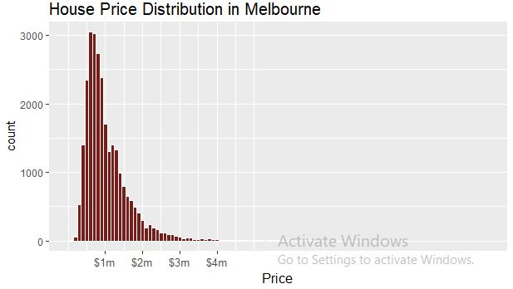
Exploratory Data Analysis

Slide 4
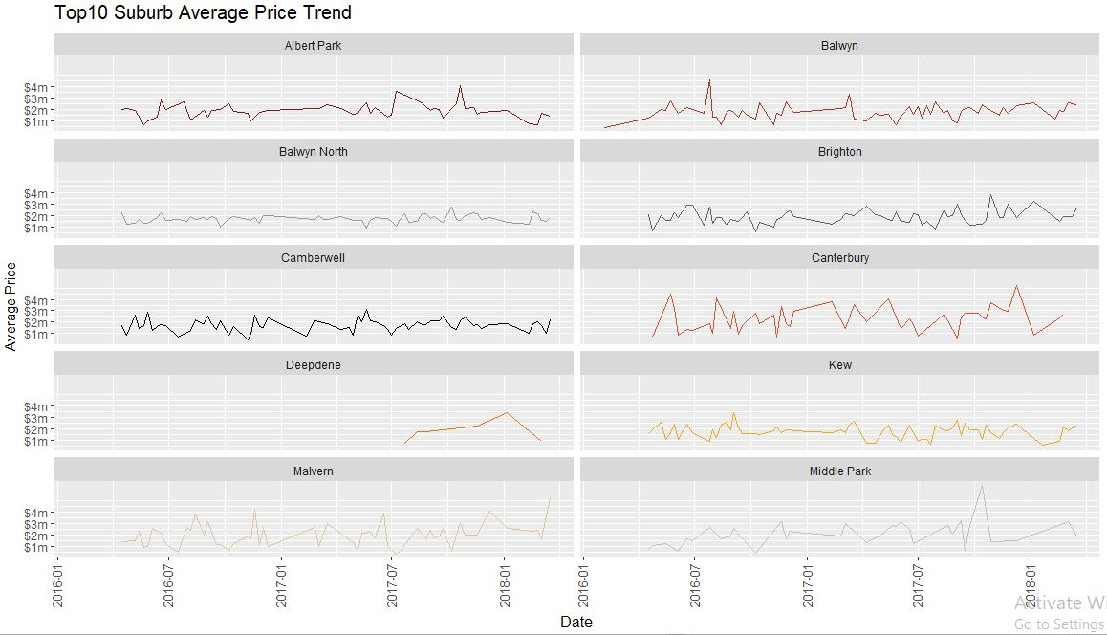

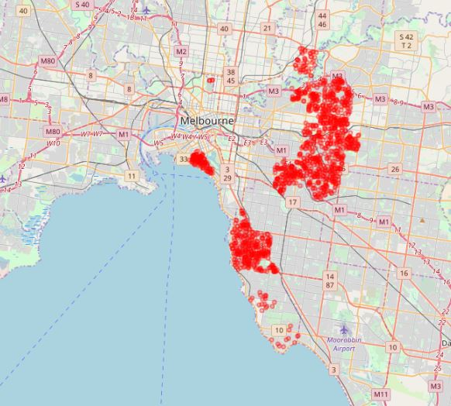
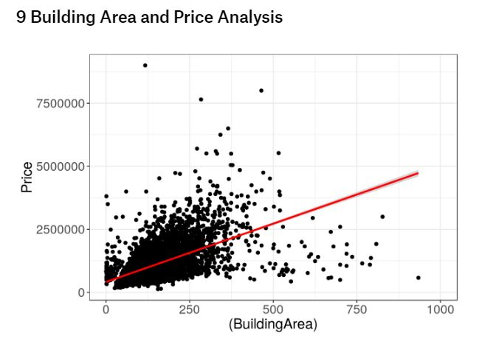
Two Content Layout with Table
Map of top 20 Priced suburbs

Slide 5
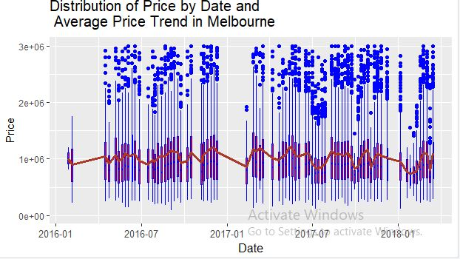
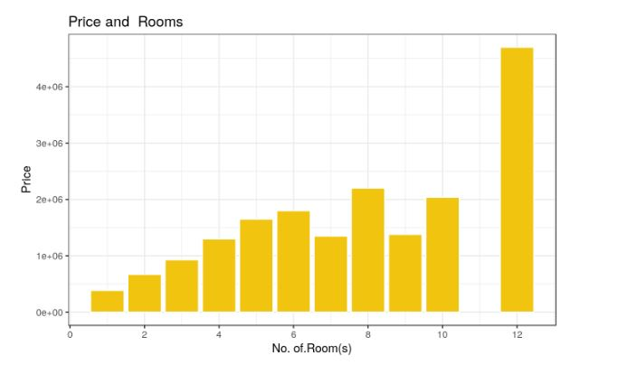
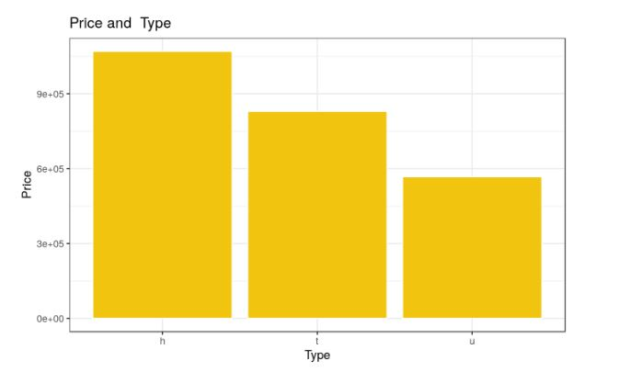
Exploratory Data Analysis

Slide 6
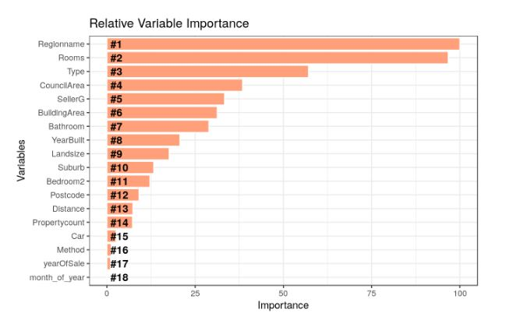
Modelling
The variables that influence the price of housing are used in Linear modelling.
The variables used are Rooms, SellerG, Ladnsize, Suburb, Regionname, CouncilArea.

Slide 7
Modelling

Slide 8
Discussion
Using visualization techniques, we have found top 10 suburbs categorized by number of houses, average price of houses, price distribution.
From the analysis, it is observed that price increases with increase in number of rooms and with increase in building area.
Also, house price clearly depends on type of house, say, cottage, villa, semi terrace houses are pricy, townhouses stand next and units/apartments are low comparatively.
From the top 10 suburb average price trend, Brighton is observed to have a fluctuating trend, the price in recent times have reduced and it is believed to increase in near future. So it can possibly be a best suburb to buy a two bedroom unit.
The expensive side of the town would be Canterbury whereas Brighton, though it fits itself in top 20 costly suburbs, its worth the money. It is also clear that being one among the top 20 costliest suburbs, it has good figure of houses too.

Slide 9
Contribution

Slide 10
Reference
https://www.kaggle.com/anthonypino/melbourne-housing-market/data
http://www.abc.net.au/news/2017-03-24/australian-property-bubble-if-it-looks-and-sounds-like-it/8383380
https://www.domain.com.au/

Slide 11


